Slide 1


CCNP SWITCH v7.1
Chapter 6: First-Hop Redundancy

Slide 2
Chapter 5 Objectives
Overview of FHRP and HSRP.
Configure and verify VRRP
Configure and verify GLBP
Notes:
Chapter 5 Objectives

Slide 3

Understanding First Hop Redundancy Protocols
Notes:
Hosts and servers in a subnet need a gateway to reach devices that are not in the same subnet. Because gateways perform a key role in operations of all devices, their availability is paramount.
Providing redundant gateways is one solution but to ensure that they operate in a way that provides redundancy and load balancing, they need be configured for first hop redundancy protocol such as HSRP, VRRP, and GLBP.
This section covers the alternatives to gateway protocols and then explains each of the first hop redundancy protocols in detail.

Slide 4
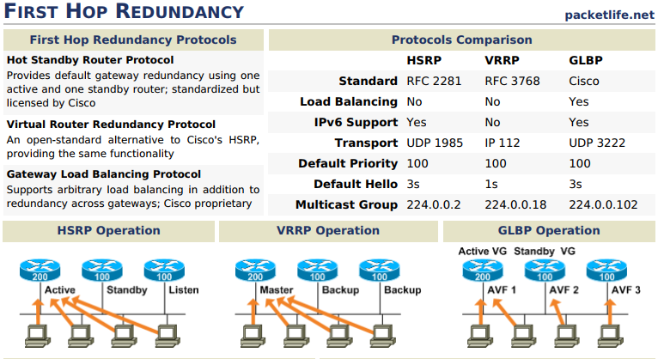
Introduction to First Hop Redundancy
Notes:
First hop redundancy protocols such as HSRP and VRRP provide default gateway redundancy with one router acting as the active gateway router with one or more other routers held in standby mode.
GLBP enables all available gateway routers to load share and be active at the same time.

Slide 5
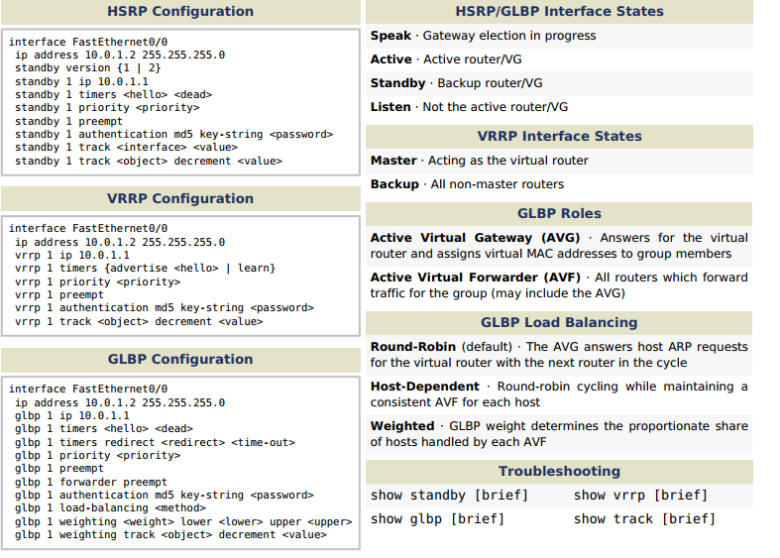
Introduction to First Hop Redundancy
Notes:
First hop redundancy protocols such as HSRP and VRRP provide default gateway redundancy with one router acting as the active gateway router with one or more other routers held in standby mode.
GLBP enables all available gateway routers to load share and be active at the same time.

Slide 6
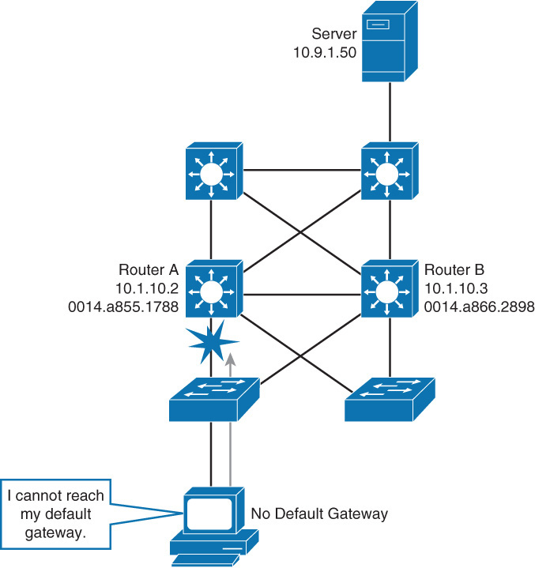
The Need for First-Hop Redundancy
Router A and Router B are connected to the 10.1.10.0/24 network.
If Router A fails, the routing protocol will dynamically converge, and Router B will forward packets.
Network hosts such as PCs printers and servers do not support dynamic routing protocols.
Whenever a host wants to communicate with a host on a different subnet, the packet must be relayed through a Layer 3 device.
This is done via proxy ARP or a default gateway setting.
If the link to the Layer 3 device fails, the host is unable to communicate with a host on another subnet.

Slide 7
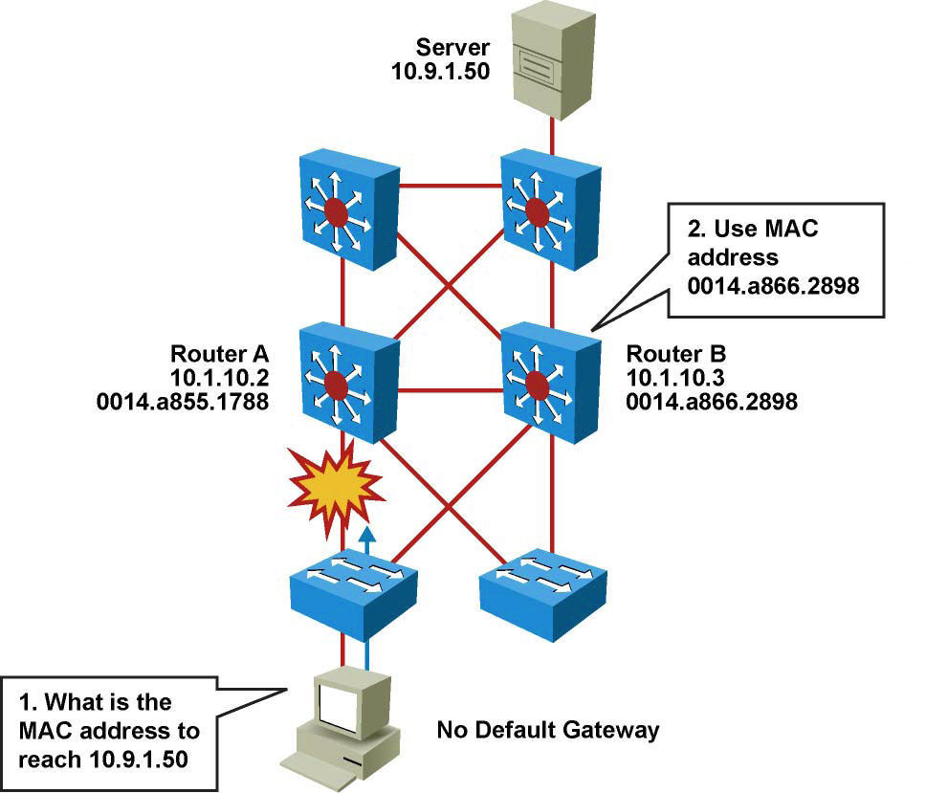
Proxy ARP
Legacy solution.
Enabled by default.
Used before default gateways were supported on IP clients.
End station acts as if destination were on same network segment.
Relatively slow due to reliance on aging out of ARP cache.
Notes:
Before default gateway was supported on most IP clients, networks were relying on the proxy ARP feature to reach IP devices outside the IP client subnet.
Cisco IOS Software ran proxy ARP to enable hosts that had no knowledge of routing options to obtain the MAC address of a gateway that can forward packets off the local subnet.
In the figure, if the proxy ARP router receives an ARP request for an IP address that it knows is not on the same interface as the request sender, it generates an ARP reply packet giving its own local MAC address as the destination MAC address of the IP address being resolved.
The host that sent the ARP request sends all packets destined for the resolved IP address to the MAC address of the router.
The router then forwards the packets toward the intended host. Proxy ARP is enabled by default.
With proxy ARP, the end-user station behaves as if the destination device were connected to its own network segment.
If the responsible router fails, the source end station continues to send packets for that IP destination to the MAC address of the failed router, and the packets are discarded.
Eventually, the proxy ARP MAC address will age out of the workstation’s ARP cache.
The workstation might eventually acquire the address of another proxy ARP failover router, but the workstation cannot send packets off the local segment during this failover time.
For further information on proxy ARP:
RFC 1027, “Using ARP to Implement Transparent Subnet Gateways.”
http://www.ciscosystems.com/en/US/tech/tk648/tk361/technologies_tech_note09186a0080094adb.shtml

Slide 8
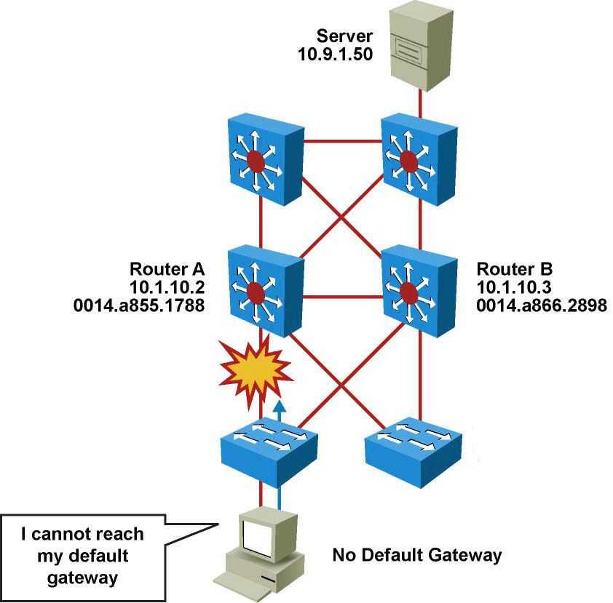
Static Default Gateway
Not dynamic.
Does not provide secondary path.
Notes:
Now that a default gateway is configured on most devices, the Proxy ARP feature is not used anymore.
Nevertheless, each client receives only one default gateway; there is no means by which to configure a secondary gateway, even if a second route exists to carry packets off the local segment.
For example, primary and secondary paths between the building access submodule and the building distribution submodule provide continuous access if a link failure occurs at the building access layer.
Primary and secondary paths between the building distribution layer and the building core layer provide continuous operations should a link fail at the building distribution layer.
In the figure, Router A is responsible for routing packets to server (10.9.1.50). If Router A becomes unavailable, routing protocols can quickly and dynamically converge and determine that Router B will now transfer packets that would otherwise have gone through Router A.
Most workstations, servers, and printers, however, do not receive this dynamic routing information.

Slide 9
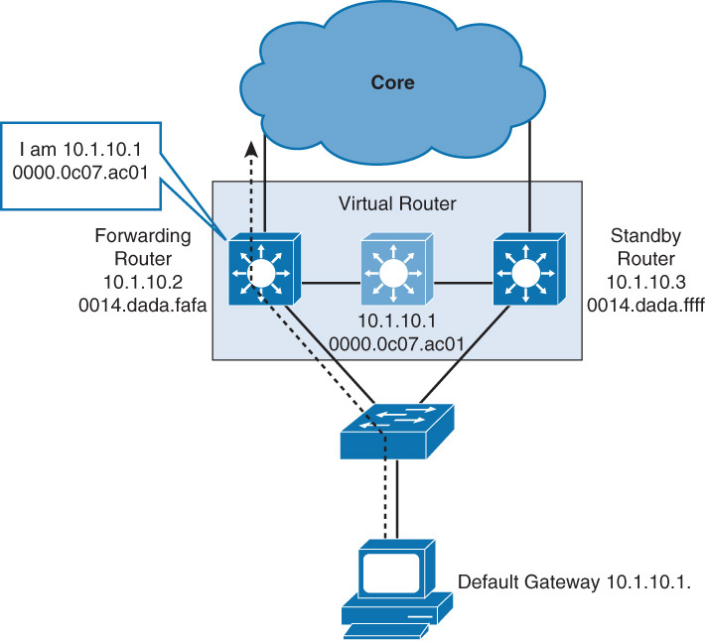
Hot Standby Router Protocol (HSRP)
Cisco-proprietary gateway redundancy protocol.
Participating routers or Layer 3 switches work together to present an illusion of a single virtual router to the hosts on the LAN.
By sharing an IP address and a MAC address, two or more routers can act as a single virtual router.
Notes:
HSRP is a redundancy protocol developed by Cisco to provide gateway redundancy without any additional configuration on the end devices in the subnet.
With HSRP configured between a set of routers, they work in concert to present the appearance of a single virtual router to the hosts on the LAN. By sharing an IP address and a MAC (Layer 2) address, two or more routers can act as a single virtual router.
The IP address of the virtual router will be configured as the default gateway for the workstations on a specific IP segment.
When frames are to be sent from the workstation to the default gateway, the workstation uses ARP to resolve the MAC address associated with the IP address of the default gateway.
The ARP resolution returns the MAC address of the virtual router. Frames sent to the MAC address of the virtual router can then be physically processed by the active router that is part of that virtual router group.
The physical router that forwards this traffic is transparent to the end stations.
HSRP provides the mechanism for determining which router should take the active role in forwarding traffic.
HSRP also has a mechanism to determine when that active role must be taken over by a standby router.
The transition from one forwarding router to another is transparent to the end devices.

Slide 10
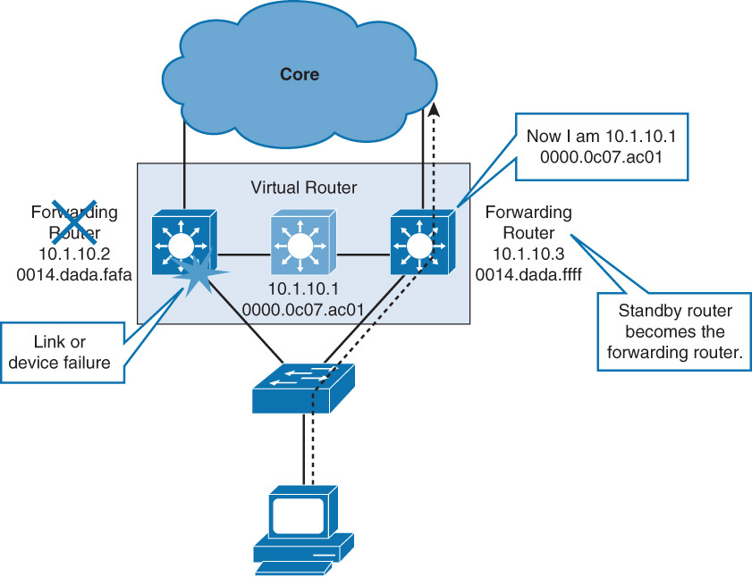
HSRP Failover
When the forwarding router or a link to it fails:
The standby router stops seeing hello messages from forwarding router.
The standby router then assumes role of forwarding router.
As the new forwarding router assumes both IP and MAC address of virtual router, end stations see no disruption in service.

Slide 11
HSRP Operation
HSRP active and standby routers send hello messages to multicast address 224.0.0.2 (all routers) for Version 1, or 224.0.0.102 for version 2, using UDP port 1985.
Hello messages used to communicated between routers within HSRP group.
All routers in HSRP group need to be L2 adjacent so that hello packets can be exchanged.
All routers in an HSRP group have specific roles and interact in specific manners:
Virtual router
Active router
Standby router
Other routers
Notes:
Virtual router: An IP and MAC address pair that end devices have configured as their default gateway.
The active router processes all packets and frames sent to the virtual router address.
The virtual router processes no physical frames. There is one virtual router in an HSRP group.
Active router: Within an HSRP group, one router is elected to be the active router.
The active router physically forwards packets sent to the MAC address of the virtual router.
There is one active router in an HSRP group.
The active router responds to traffic for the virtual router.
If an end station sends a packet to the virtual router MAC address, the active router receives and processes that packet.
If an end station sends an ARP request with the virtual router IP address, the active router replies with the virtual router MAC address.
Standby Router: Listens for periodic hello messages. When the active router fails, the other HSRP routers stop seeing hello messages from the active router.
The standby router then assumes the role of the active router. There is one standby router in an HSRP group.
Other Routers: There can be more than two routers in a HSRP group but only one active and one standby router is possible.
The other routers remain in the initial state and if both the active and standby routers fail, all routers in the group contend for the active and standby router roles.

Slide 12
HSRP Operation – Virtual Router
Virtual router
An IP and MAC address pair that end devices have configured as their default gateway.
The active router processes all packets and frames sent to the virtual router address.
The virtual router processes no physical frames. There is one virtual router in an HSRP group.

Slide 13
HSRP Operation – Active Router
Active Router
Within an HSRP group, one router is elected to be the active router.
The active router physically forwards packets sent to the MAC address of the virtual router.
There is one active router in an HSRP group.
The active router responds to traffic for the virtual router.
If an end station sends a packet to the virtual router MAC address, the active router receives and processes that packet.
If an end station sends an ARP request with the virtual router IP address, the active router replies with the virtual router MAC address.

Slide 14
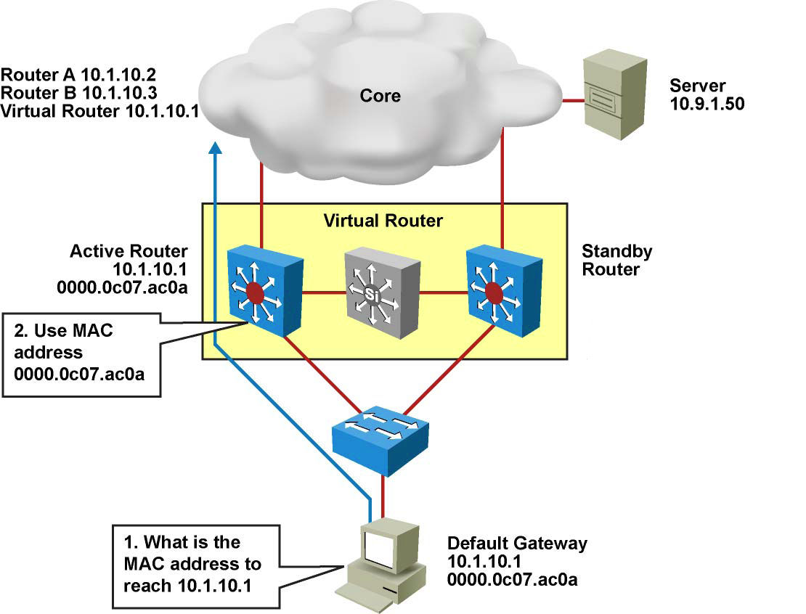
HSRP Operation – Active Router
Router A assumes the active role and forwards all frames addressed to the assigned HSRP MAC address of 0000.0c07.acxx, where xx is the HSRP group identifier.

Slide 15
HSRP Operation – Standby and Other Routers
Standby Router:
Listens for periodic hello messages.
When the active router fails, the other HSRP routers stop seeing hello messages from the active router.
The standby router then assumes the role of the active router. There is one standby router in an HSRP group.
Other Routers:
There can be more than two routers in a HSRP group but only one active and one standby router is possible.
The other routers remain in the initial state and if both the active and standby routers fail, all routers in the group contend for the active and standby router roles.

Slide 16
HSRP State Transition
A router in an HSRP group can be in one of these states: initial, listen, speak, standby, or active.
When a router exists in one of these states, it performs the actions required for that state.
Not all HSRP routers in the group will transition through all states.
State | Definition
Initial | The beginning state. The initial state indicates that HSRP does not run. This state is entered via a configuration change or when an interface first comes up.
Listen | The router knows the virtual IP address, but the router is neither the active router nor the standby router. It listens for hello messages from those routers.
Speak | The router sends periodic hello messages and actively participates in the election of the active or standby router. A router cannot enter speak state unless the router has the virtual IP address.
Standby | The router is a candidate to become the next active router and sends periodic hello messages. With the exclusion of transient conditions, there is, at most, one router in the group in standby state.
Active | The router currently forwards packets that are sent to the group virtual MAC address. The router sends periodic hello messages. With the exclusion of transient conditions, there must be, at the most, one router in the active state in the group.
Notes:
A router in an HSRP group can be in one of these states: initial, listen, speak, standby, or active.
When a router exists in one of these states, it performs the actions required for that state.
Not all HSRP routers in the group will transition through all states.
For example, if there were three routers in the HSRP group, the router that is not the standby or active router will remain in the listen state.

Slide 17
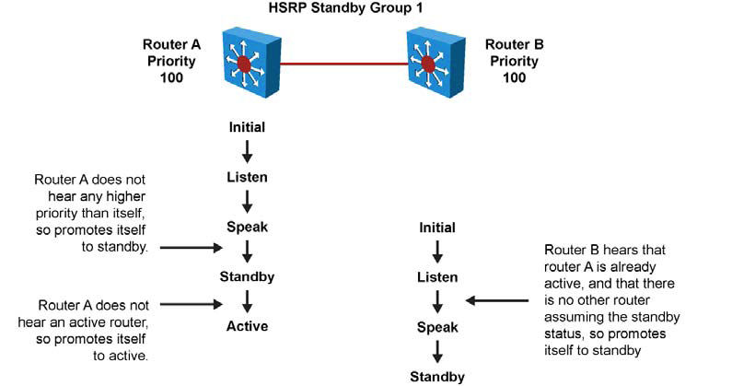
HSRP State Transition
Router A starts. As it is the first router for standby Group 1 in the subnet, it transits through the listen and speak states and then becomes the active router.
Router B starts after Router A. While Router B is in listen state, Router A is already assuming the standby and then the active role. As there is already an existing active router, Router B assumes the standby role.
Notes:
All routers begin in the initial state, which is the starting state and indicates that HSRP is not running.
This state is entered via a configuration change, such as when HSRP is enabled on an interface, or when an HSRP-enabled interface is first brought up, such as when the no shutdown command is issued.
The purpose of the listen state is to determine if there are already active or standby routers for the group.
In the speak state, the routers are actively participating in the election of the active router or standby router or both.
HSRP uses the hello and hold time to determine when it moves to different states.
The timers are explained later.
When two routers participate in an election process, a priority can be configured to determine which router should be active.
Without specific priority configuration, each router has a default priority of 100, and the router with the highest IP address is elected as the active router.
Regardless of other routers priorities or IP addresses, an active router will stay active by default.
A new election occurs only if the active router is removed. When the standby router is removed, a new election is made to replace the standby.
This default behavior can be changed with the option preempt, examined later.

Slide 18
HSRP State Transition
50
Router A starts. As it is the first router for standby Group 1 in the subnet, it transits through the listen and speak states and then becomes the active router.
Router B starts after Router A. While Router B is in listen state, Router A is already assuming the standby and then the active role. As there is already an existing active router, Router B assumes the standby role. This is true even though it has the higher priority. By default the active router will not give up its active role even to one that has a higher priority.
Notes:
All routers begin in the initial state, which is the starting state and indicates that HSRP is not running.
This state is entered via a configuration change, such as when HSRP is enabled on an interface, or when an HSRP-enabled interface is first brought up, such as when the no shutdown command is issued.
The purpose of the listen state is to determine if there are already active or standby routers for the group.
In the speak state, the routers are actively participating in the election of the active router or standby router or both.
HSRP uses the hello and hold time to determine when it moves to different states.
The timers are explained later.
When two routers participate in an election process, a priority can be configured to determine which router should be active.
Without specific priority configuration, each router has a default priority of 100, and the router with the highest IP address is elected as the active router.
Regardless of other routers priorities or IP addresses, an active router will stay active by default.
A new election occurs only if the active router is removed. When the standby router is removed, a new election is made to replace the standby.
This default behavior can be changed with the option preempt, examined later.

Slide 19
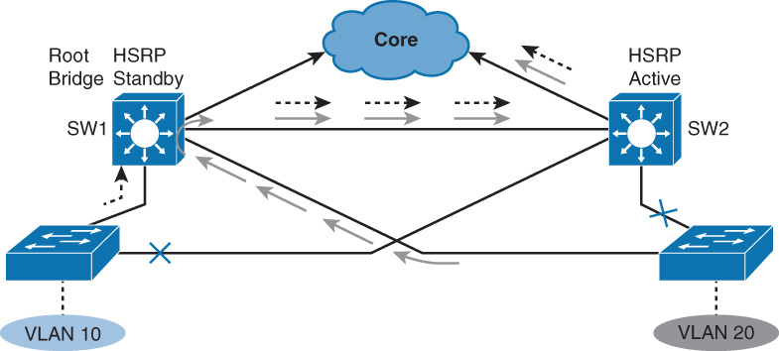
Aligning HSRP with STP Topology
In a redundant spanning-tree topology, some links are blocked. The spanning-tree topology has no awareness about the HSRP configuration. There is no automatic relationship between the HSRP active router election process and the Spanning Tree Root Bridge election.
When configuring both spanning tree and HSRP (or any other first hop redundancy protocol), you must make sure that the active router is the same as the root bridge for the corresponding VLAN. When the root bridge is different from the HSRP active router, a suboptimal path can result, as illustrated.

Slide 20
Configuring HSRP
Configure HSRP on the interface.
Switch(config-if)#
standby group-number ip ip-address
The group number is optional and indicates the HSRP group to which this interface belongs.
Specifying a unique group number in the standby commands enables the creation of multiple HSRP groups. The default group is 0.
The IP address is that of the virtual router IP address for the HSRP group.
Notes:
While running HSRP, the end-user stations must not discover the actual MAC addresses of the routers in the standby group.
Any protocol that informs a host of a router’s actual address must be disabled.
To ensure that the actual addresses of the participating HSRP routers are not discovered, enabling HSRP on a Cisco router interface automatically disables ICMP redirects on that interface.
After the standby ip command is issued, the interface changes to the appropriate state.
When the command is successfully executed, the router issues an HSRP message.

Slide 21
Configuring HSRP Priority and Preempt
To set the HSRP priority value of a router, enter this command in interface configuration mode:
standby group-number priority priority-value
The priority value can be from 0 to 255. The default value is 100.
During the election process, the router with the highest priority in an HSRP group becomes the active router. If a tie occurs, the router with the highest configured IP address becomes active.
If the routers do not have preempt configured, a router that boots up significantly faster than the others in the standby group becomes the active router, regardless of the configured priority. The former active router can be configured to resume the forwarding router role by preempting a router with a lower priority.
To enable a router to resume the forwarding router role, enter this command in interface configuration mode:
standby [group-number] preempt [delay {minimum seconds reload seconds sync seconds}]
Notes:
Each standby group has its own active and standby routers.
A network engineer can assign a priority value to each router in a standby group, thus controlling the order in which active routers for that group are selected.

Slide 22
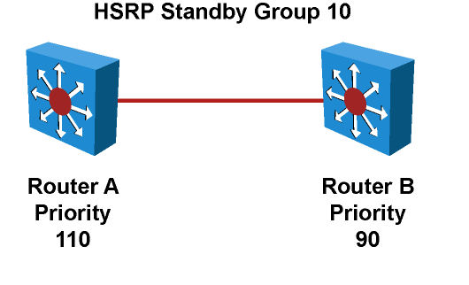
HSRP Configuration Example
Routers A and B are configured with priorities of 110 and 90, respectively. The configuration of Router A is displayed.
The preempt keyword ensures that Router A will be the HSRP active router as long its interface is active.
RouterA(config)# interface vlan 10
RouterA(config-if)# ip address 10.1.1.2 255.255.255.0
RouterA(config-if)# standby 10 ip 10.1.1.1
RouterA(config-if)# standby 10 priority 110
RouterA(config-if)# standby 10 preempt
RouterB(config)# interface vlan 10
RouterB(config-if)# ip address 10.1.1.3 255.255.255.0
RouterB(config-if)# standby 10 ip 10.1.1.1
RouterA(config-if)# standby 10 priority 90
RouterA(config-if)# standby 10 preempt
Notes:
To remove the interface from preemptive status, enter the no standby group preempt command.

Slide 23
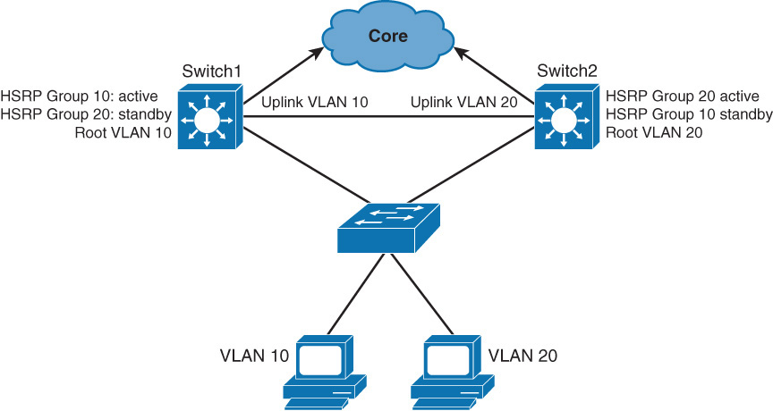
Load Sharing with HSRP
HSRP allows for only one active router in the same subnet. In a typical network, engineers would want to use all available routers to load share the traffic going across the network. Multigroup HSRP enables routers to simultaneously provide redundant backup and perform load sharing across different IP subnets.
In the figure, two HSRP-enabled routers participate in two separate VLANs, using 802.1Q. Running HSRP over trunks enables users to configure redundancy among multiple routers that are configured as front ends for VLAN IP subnets.
Notes:
By configuring HSRP over trunks, users can eliminate situations in which a single point of failure causes traffic interruptions.
This feature inherently provides some improvement in overall networking resilience by providing load balancing and redundancy capabilities between subnets and VLANs.
For a VLAN, configure the same device to be both the spanning-tree root and the HSRP active router.
This approach ensures that the Layer 2 forwarding path leads directly to the Layer 3 active router and so achieves maximum efficiency of load balancing on the routers and the trunks.
For each VLAN, a standby group, an IP addresses, and a single well-known MAC address with a unique group identifier is allocated to the group.
Although up to 255 standby groups can be configured (4095 with version 2), it is advised that the actual number of group identifiers used be kept to a minimum.
When you are configuring two distribution layer switches, typically you will require only two standby group identifiers, regardless of how many standby groups are created.

Slide 24
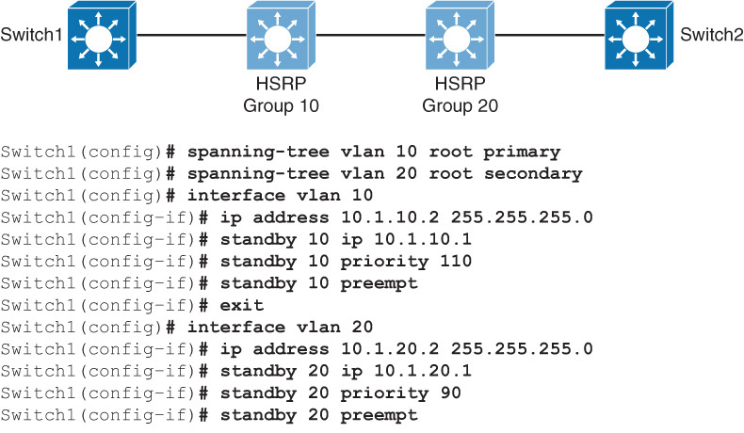
Load Sharing with HSRP
Notes:
The figure shows the configuration for two HSRP groups for two VLANs and the corresponding STP root configuration.
The left switch is root and active HSRP router for VLAN 10. The corresponding configuration of the right switch has the switch as root and active HSRP router for VLAN 20.

Slide 25
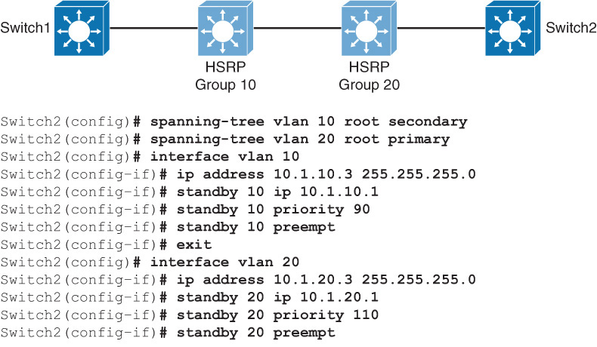
Load Sharing with HSRP

Slide 26
The Need for Interface Tracking with HSRP
HSRP can track interfaces or objects and decrement priority if an interface or object fails.
Enables priority of active group router to be automatically adjusted based on availability of tracked interfaces.
When tracked interface becomes unavailable, HSRP priority is decreased.
When properly configured, the HSRP tracking feature ensures the router with unavailable interface relinquishes active router role.
When the conditions that are defined by the object are fulfilled, the router priority remains the same.
As soon as the verification that is defined by the object fails, the router priority is decremented. The amount of decrease can be configured. The default value is 10.

Slide 27
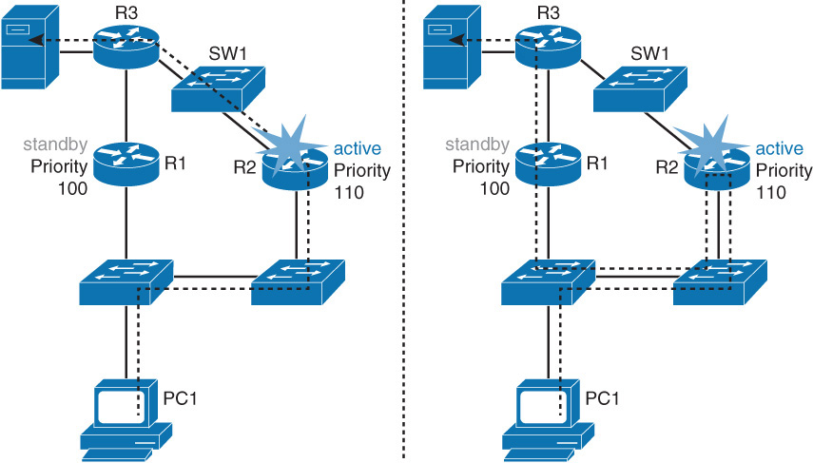
HSRP Interface Tracking
HSRP does not have a built in mechanism for detecting link failures in starting the HSR re-election process.
With no interface tracking feature enabled, when R2’s uplink fails as indicated, R2 remains the active, and a suboptimal path is taken from R2 to R1

Slide 28
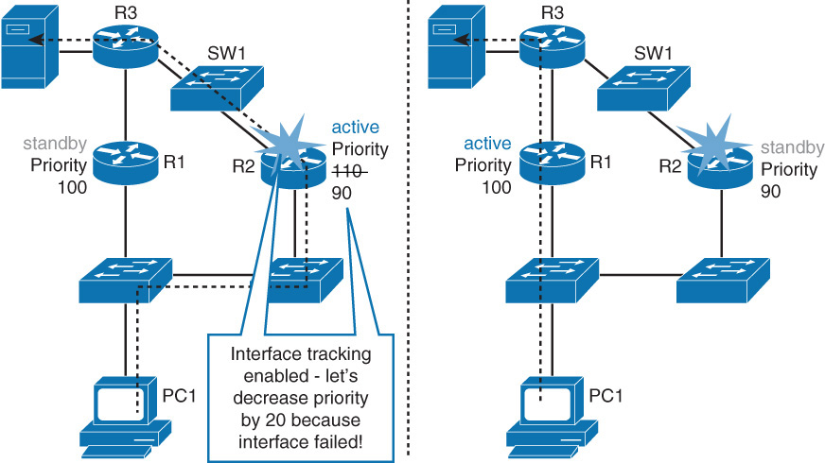
HSRP with Interface Tracking On
R2's uplink interface fails, HSRP, by virtue of HSRP interface tracking, HSRP detects this failure, and R2's HSRP priority is decreased by 20. We now have an optimal traffic path.

Slide 29
HSRP Interface Tracking
Configure interface tracking.
Switch(config-if)
standby [group-number] track interface-type interface-number [interface-priority]
Variable | Description
group-number | (Optional) Indicates the group number on the interface to which the tracking applies. The default number is 0.
interface-type | Indicates the interface type (combined with the interface number) that will be tracked.
interface-number | Indicates the interface number (combined with the interface type) that will be tracked.
interface-priority | (Optional) Indicates the amount by which the hot standby priority for the router is decremented when the interface becomes disabled. The priority of the router is incremented by this amount when the interface becomes available. The default value is 10.
Notes:
A router can track several interfaces. In the figure, SW4 tracks both fa0/23 and fa0/24.
The configuration policy shown states that SW4 initial priority should be 110. SW3 initial priority should be left to its default value, 100.
If SW4 loses its link fa0/24 to SW1, SW4 priority should become the same as SW3 priority.
If a new election needs to occur, both multilayer switches have the same chances of becoming the active router.
This decrement is made because fa0/24 is not the active link but just a backup.
If fa0/23 (the active uplink) is lost, SW4 priority becomes lower than SW3 priority. If both fa0/23 and fa0/24 are lost, both decrements are applied and SW4 priority becomes 80.

Slide 30
HSRP Interface Tracking Example
The following shows the configuration of router 2. Note the standby 10 track ethernet 0/1 20 lowers a priority 20 points as soon as interface ethernet 0/1 goes down.
R2(config)# interface ethernet0/1
R2(config-if)# ip address 192.168.10.1 255.255.255.0
R2(config-if)# standby 10 ip 192.168.10.254
R2(config-if)# standby 10 priority 110
R2(config-if)# standby 10 preempt
R2(config-if)# standby 10 track ethernet1/1 20
Use the show track track-number command to verify the state of the tracked interface.
Use the show standby command to verify that tracking is configured

Slide 31
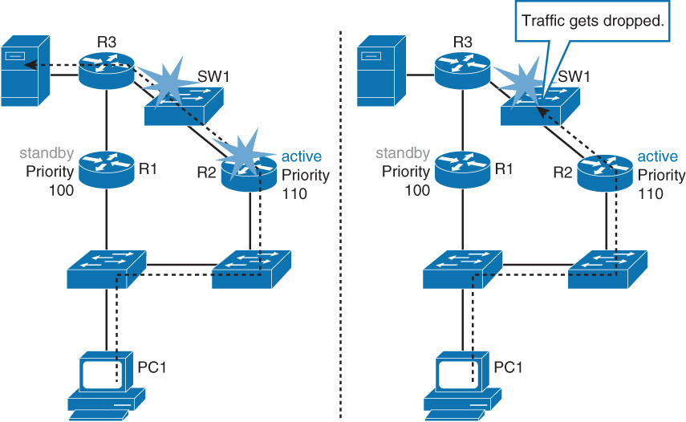
HSRP and Object Tracking
HSRP interface tracking cannot track non-directly connected links.
This can be seen in the following scenario.

Slide 32
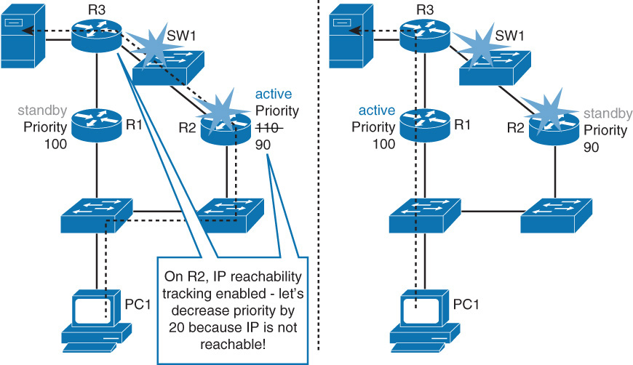
HSRP and Object Tracking
With HSRP object tracking, HSRP is able to react to changes in the status of objects, such as the reachability in the link between SW1 and R3 as shown here:

Slide 33
HSRP Object Tracking
Tracked objects are defined in global configuration with the track keyword, followed by an object number.
You can track up to 500 objects.
Switch(config)# track 1 ?
interface Select an interface to track
ip IP protocol
list Group objects in a list
ip sla Response Time Reporter (RTR) entry
A few of the commonly available include the following:
An Interface
IP route
IP SLA
A list of objects
Notes:
Tracked objects offer a vast group of possibilities. You can track the following:
An interface: Just like the standby track interface command, a tracking object can verify the interface status (line-protocol).
You can also track ip routing on the interface.
This option tracks whether IP routing is enabled, whether an IP address is configured on the interface, and whether the interface state is up before reporting to the tracking client that the interface is up.
IP route: A tracked IP-route object is considered up and reachable when a routing table entry exists for the route and the route is not inaccessible. T
o provide a common interface to tracking clients, route metric values are normalized to the range of 0 to 255, where 0 is connected and 255 is inaccessible.
You can track route reachability, or even metric values to determine best paths values to the target network.
The tracking process uses a per-protocol configurable resolution value to convert the real metric to the scaled metric.
The metric value communicated to clients is always such that a lower metric value is better than a higher metric value.
A list of objects: Several objects can be tracked and their result compared to determine if one or several of them should trigger the “success” of “fail” condition.
IP SLA: This special case enables you to track advanced parameters, such as IP reachability, delay, or jitter.

Slide 34
Configuring R2 with an IP SLA Test
Configure an IP SLA test that will track the reachability of R3's SW1- facing interface.
First define an IP SLA ICMP echo test:
R2(config)#ip sla 10
R2(config-ip-sla)#icmp-echo 192.168.3.2
R2(config-ip-sla-echo)# frequency 5
R2(config-ip-sla-echo)#Ip sla schedule 10 life for ever start-time now
Then create an object and track the IP SLA instance:
R2(config #track 100 ip sla 10
Then configure HSR to track an object and decrement priority if the test fails:
R2(config)#interface ethernet0/1
R2(config-if)#standby 1 track 100 decrement 20
Verify tracking with the show standby command
If not using SLA can track interface as an object.
R2(config #track 100 interface ethernet0/1 line-protocol

Slide 35
HSRP Authentication
HSRP authentication prevents rogue routers on the network from joining the HSRP group. HSRP authentication is enabled by configuration of an authentication string on all member devices of the HSRP group.
The authentication string is a maximum of 8 characters and the default keyword is cisco.
RouterA(config)# interface vlan 10
RouterA(config-if)# ip address 10.1.1.2 255.255.255.0
RouterA(config-if)# standby 10 ip 10.1.1.1
RouterA(config-if)# standby 10 priority 110
RouterA(config-if)# standby 10 preempt
RouterA(config-if)# standby 10 authentication xyz123

Slide 36
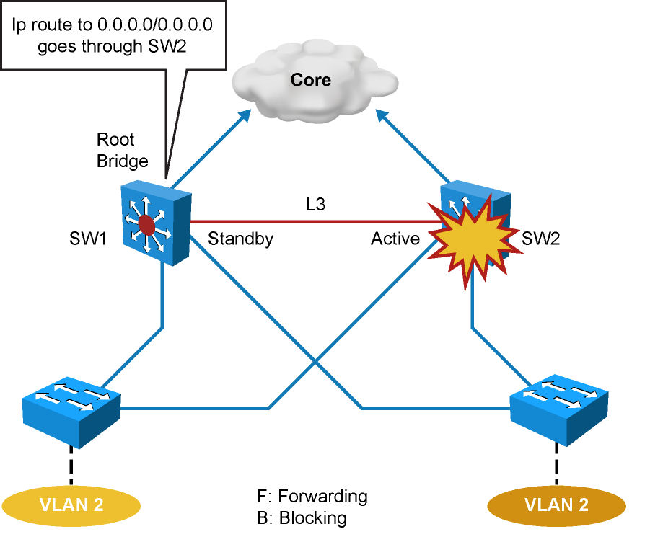
HSRP Timer Considerations and Configuration
Variable | Description
group-number | (Optional) Group number on the interface to which the timers apply. The default is 0.
msec | (Optional) Interval in milliseconds. Millisecond timers allow for faster failover.
hellotime | Hello interval in seconds. This is an integer from 1 through 255. The default is 3 seconds.
holdtime | Time, in seconds, before the active or standby router is declared to be down. This is an integer from 1 through 255. The default is 10 seconds.
Notes:
When an HSRP active router fails, the standby router detects the failure and assumes the active role.
This mechanism relies on hello messages and holdtime intervals. The hello timer determines how often routers in the same Standby group exchange messages.
The holdtime timer determines the time before the active or standby router is declared to be down.
Ideally, to achieve fast convergence, these timers should be configured to be as low as possible.
Within milliseconds after the active router fails, the standby router can detect the failure, expire the holdtime interval, and assume the active role.
Nevertheless, timers configuration should also take into account other parameters relevant to the network convergence.
For example, both HSRP routers might be running a dynamic routing protocol.
The routing protocol probably has no awareness of the HSRP configuration and sees both routers as individual hops toward other subnets.
If HSRP failover occurs before the dynamic routing protocol converges, suboptimal routing information might still exist.
In a worst-case scenario, the dynamic routing protocol continues seeing the failed router as the best next hop to other networks, and packets are lost, as shown in the figure.
When configuring HSRP timers, make sure that they harmoniously match the other timers that can influence which path is chosen to carry packets in your network.
The hello message contains the priority of the router and hellotime and holdtime parameter values.
The standby timer includes an msec parameter to allow for subsecond failovers.
Lowering the hello timer results in increased traffic for hello messages and should be used cautiously.
If an active router sends a hello message, receiving routers consider that hello message to be valid for one holdtime.
The holdtime value should be at least three times the value of the hellotime. The holdtime value must be greater than the value of the hellotime.
HSRP timers can be adjusted to tune the performance of HSRP on distribution devices, thereby increasing their resilience and reliability in routing packets off the local VLAN.
By default, HSRP hellotime is 3 seconds and holdtime is 10 seconds, which means that failover time could be as much as 10 seconds for clients to start communicating with the new default gateway.
In some cases, this interval might be excessive for application support.
The hellotime and the holdtime parameters are both configurable.
To configure the time between hello messages and the time before other group routers declare the active or standby router to be nonfunctioning, enter this command in interface configuration mode:
Switch(config-if)# standby group-number timers [msec] hellotime holdtime
Hello and dead timer intervals must be identical for all devices within the HSRP group.
The table describes the options for standby message timer configuration.
To reinstate the default standby-timer values, enter the no standby group timers command.
The HSRP hellotime and holdtime can be set to millisecond values so that HSRP failover occurs in less than 1 second.
Preempt is an important feature of HSRP that enables the primary router to resume the active role when it comes back online after a failure or maintenance event.
Preemption is a desired behavior because it forces a predictable routing path for the VLAN during normal operations and ensures that the Layer 3 forwarding path for a VLAN parallels the Layer 2 STP forwarding path whenever possible.
When a preempting device is rebooted, HSRP preempt communication should not begin until the distribution switch has established full connectivity to the rest of the network.
This enables the routing protocol convergence to occur more quickly, after the preferred router is in an active state.
To accomplish this, measure the system boot time and set the HSRP preempt delay to a value of 50 percent greater than the boot time.
This ensures that the primary distribution switch establishes full connectivity to the network before HSRP communication occurs.
For example, if the boot time for the distribution device is 150 seconds, the preempt delay should be set to 225 seconds.

Slide 37
HSRP Timers Configuration Example
RouterA(config)# interface vlan 10
RouterA(config-if)# ip address 10.1.1.2 255.255.255.0
RouterA(config-if)# standby 10 ip 10.1.1.1
RouterA(config-if)# standby 10 priority 110
RouterA(config-if)# standby 10 preempt
RouterA(config-if)# standby 10 authentication xyz123
RouterA(config-if)# standby 10 timers msec 200 msec 750
RouterA(config-if)# standby 10 preempt delay minimum 225
Notes:
The example shows the configuration of timers and the preempt delay configuration commands.

Slide 38
HSRP Versions
HSRP version 1 is the default in IOS and it enables group numbers up to 255. Because one can have up to 4095 VLANs, one has to reuse the same HSRP group number on multiple interfaces if needed. This is allowed even though it might cause some confusion.
HSRPv1 uses the Virtual MAC address of the form 0000.0C07.ACXX (XX = HSRP group), and the HSRPv1 hello packets are sent to multicast address 224.0.0.2.
HSRP version 2 has been added to IOS since 12.2 46SE or later and it enables group numbers up to 4095. This enables you to use the VLAN number as the group number.
With HSRPv2, the MAC address of the virtual router and the multicast address for the hello messages has been changed. The virtual MAC address is 0000.0C9F.FXXX (XXX=HSRP group), and hello packets are sent to multicast address 224.0.0.102.
HSRPv2 has a different packet format from HSRPv1. Ensure that the same version is configured on all routers in a HSRP group. Otherwise hello messages are not understood. Version 1 is the default.
Use the following command to change the version:
Switch(config-if)# standby <hsrp group number> version 2

Slide 39
HSRP Monitoring (1)
Use the show standby family of commands to verify HSRP state. Several arguments can be used.
The show standby brief command displays a summary of the HSRP configurations.
For each standby group, you can verify the local router neighbors.
Switch# show standby brief
P indicates configured to preempt.
|
Interface Grp Pri P State Active Standby Virtual IP
Vl10 10 120 P Active local 10.1.10.3 10.1.10.1
Vl20 20 90 P Standby 10.1.20.3 local 10.1.20.1
Switch#show standby neighbor vlan10
HSRP neighbors on Vlan10
10.1.10.3
Active groups: 10
No standby groups

Slide 40
HSRP Monitoring (2)
When simply typing show standby, a complete display is provided.
Switch# show standby
Vlan10 - Group 10
State is Active
Virtual IP address is 10.1.10.1
Active virtual MAC address is 0000.0c07.ac0a
Local virtual MAC address is 0000.0c07.ac0a (v1 default)
Hello time 3 sec, hold time 10 sec
Next hello sent in 1.248 secs
Preemption enabled
Active router is local
Standby router is 10.1.10.3, priority 90 (expires in 10.096 sec)
Priority 120 (configured 120)
Track interface Port-channel31 state Up decrement 30
Track interface Port-channel32 state Up decrement 30
Group name is “hsrp-Vl10-10” (default)
Vlan20 - Group 20
State is Standby
Virtual IP address is 10.1.20.1 Active virtual MAC address is 0000.0c07.ac14
Local virtual MAC address is 0000.0c07.ac14 (v1 default)
Hello time 3 sec, hold time 10 sec
Next hello sent in 2.064 secs
Preemption enabled
Active router is 10.1.10.3, priority 120 (expires in 10.032 sec)
Standby router is local
Priority 90 (configured 90)
Group name is “hsrp-Vl20-20” (default)

Slide 41
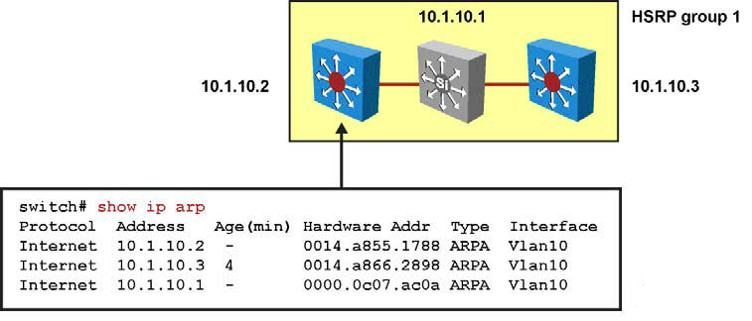
HSRP Monitoring (3)
The IP address and corresponding MAC address of the virtual router are maintained in the ARP table of each router in an HSRP group.
The command show ip arp displays the ARP cache on a multilayer switch.

Slide 42
HSRP Debug Commands
Command | Description
Switch# debug standby [errors] [events] [packets] | Displays all state changes to HSRP, including all hello packets. Arguments minimize output.
Switch# debug standby terse | Displays all HSRP errors, events, and packets, except hello and advertisement packets.

Slide 43
Virtual Router Redundancy Protocol (VRRP)
Notes:
Hosts and servers in a subnet need a gateway to reach devices that are not in the same subnet. Because gateways perform a key role in operations of all devices, their availability is paramount.
Providing redundant gateways is one solution but to ensure that they operate in a way that provides redundancy and load balancing, they need be configured for first hop redundancy protocol such as HSRP, VRRP, and GLBP.
This section covers the alternatives to gateway protocols and then explains each of the first hop redundancy protocols in detail.

Slide 44
About VRRP
Virtual Router Redundancy Protocol (VRRP) provides router interface failover in a manner similar to HSRP but with added features and IEEE compatibility.
Like HSRP, VRRP enables a group of routers to form a single virtual router. In an HSRP or VRRP group, one router is elected to handle all requests sent to the virtual IP address.
With Hot Standby Router Protocol (HSRP), this is the active router.
A HSRP group has one active router, one standby router, and perhaps many listening routers.
A VRRP group has one master router and one or more backup routers.
HSRP and VRRP are similar in their features and behaviors.

Slide 45
About VRRP
The main difference is that HSRP is a Cisco proprietary implementation, whereas VRRP is an open standard.
VRRP offers these redundancy features:
VRRP provides redundancy for the real IP address of a router or for a virtual IP address shared among the VRRP group members.
If a real IP address is used, the router with that address becomes the master.
If a virtual IP address is used, the master is the router with the highest priority.
A VRRP group has one master router and one or more backup routers.
The master router uses VRRP messages to inform group members that it is the master.

Slide 46
Virtual Router Redundancy Protocol (VRRP)
HSRP | VRRP
HSRP is a Cisco proprietary protocol, created in 1994, and formalized with the RFC 2281 in March 1998. | VRRP is an IEEE standard (RFC 2338 in 1998; then RFC 3768 in 2005) for router redundancy.
16 groups max. | 255 groups max.
1 active, 1 standby, several candidates. | 1 active, several backups.
Virtual IP is different from Active and Standby real IP addresses. | Virtual IP can be the same as one of the group members real IP address.
Uses 224.0.0.2 for hello packets. | Uses 224.0.0.18 for hello packets.
Default timers: hello 3 s, holdtime 10 s. | The default timers are shorter in VRRP than HSRP. This often gave VRRP the reputation of being faster than HSRP.
Can track interfaces or objects. | Can track only objects.
Uses authentication within each group by default. When authentication is not configured, a default authentication, using “cisco” as the password. | Supports plaintext and HMAC/MD5 authentication methods (RFC 2338). The new VRRP RFC (RFC 3768) removes support for these methods. The consequence is that VRRP does not support authentication anymore. Nevertheless, current Cisco IOS still supports the RFC 2338 authentications mechanisms.
Notes:
Virtual Router Redundancy Protocol (VRRP) provides router interface failover in a manner similar to HSRP but with added features and IEEE compatibility.
Like HSRP, VRRP enables a group of routers to form a single virtual router. In an HSRP or VRRP group, one router is elected to handle all requests sent to the virtual IP address.
With Hot Standby Router Protocol (HSRP), this is the active router.
A HSRP group has one active router, one standby router, and perhaps many listening routers.
A VRRP group has one master router and one or more backup routers.
HSRP and VRRP are similar in their features and behaviors.
The main difference is that HSRP is a Cisco proprietary implementation, whereas VRRP is an open standard.
The consequence is that HSRP is usually found in Cisco networks. VRRP is used in multivendor implementations.
VRRP offers these redundancy features:
VRRP provides redundancy for the real IP address of a router or for a virtual IP address shared among the VRRP group members.
If a real IP address is used, the router with that address becomes the master.
If a virtual IP address is used, the master is the router with the highest priority.
A VRRP group has one master router and one or more backup routers.
The master router uses VRRP messages to inform group members that it is the master.

Slide 47
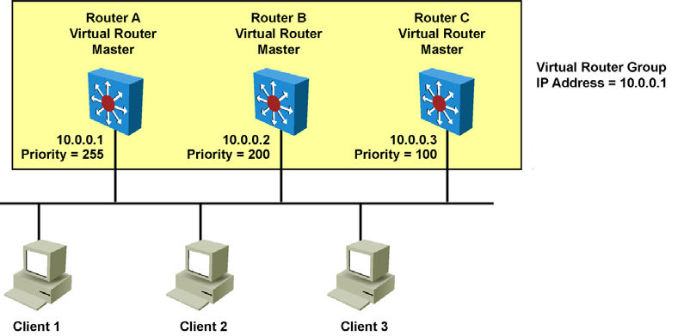
VRRP Scenario
Backup
Backup
Routers A, B, and C are members of a VRRP group. The IP address of the virtual router is the same as that of the LAN interface of Router A (10.0.0.1). Router A is responsible for forwarding packets sent to this IP address.
The clients have a gateway address of 10.0.0.1. Routers B and C are backup routers. If the master router fails, the backup router with the highest priority becomes the master router. When Router A recovers, it resumes the role of master router.

Slide 48
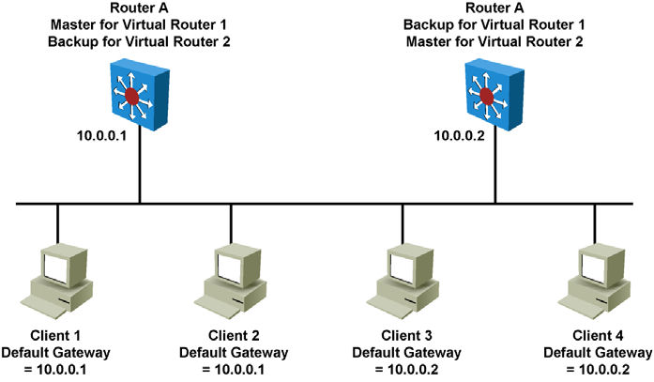
VRRP Scenario – Load Balancing
Here is a LAN topology in which VRRP is configured so that Routers A and B share the load of being the default gateway for Clients 1 through 4. Routers A and B act as backup virtual routers to one another should either one fail.
Two virtual router groups are configured. For virtual Router 1, Router A is the owner of IP address 10.0.0.1 and is therefore the master virtual router for clients configured with that default gateway address. Router B is the backup virtual router to Router A.
For virtual Router 2, Router B is the owner of IP address 10.0.0.2 and is the master virtual router for clients configured with the default gateway IP address 10.0.0.2. Router A is the backup virtual router to Router B.
Notes:
Given that the IP address of the VRRP group is that of a physical interface on one of the group members, the router owning that address will be the master in the group.
Its priority is set to 255. Backup router priority values can range from 1 to 254; the default value is 100.
The priority value zero has special meaning, indicating that the current master has stopped participating in VRRP.
This setting is used to trigger backup routers to quickly transition to the master without having to wait for the current master to time out.
With VRRP, only the master sends advertisements (the equivalent of HSRP hellos).
The master sends the advertisement on multicast 224.0.0.18 protocol number 112 on a default interval of 1 second.

Slide 49
VRRP Scenario – Transition Process
Step | Description | Notes
1. | Router A is currently the master, so it sends advertisements by default every 1 second. | Router A is the only device sending advertisements.
2. | Router A fails. | Advertisements stop.
3. | Router B and Router C stop receiving advertisements and wait for their respective master down interval to expire before transitioning to the master state. | By default, the master down interval is 3 seconds plus the skew time.
4. | Because the skew time is inversely proportional to priority, the master down interval of Router B is less than that of Router C. Router B has a master down interval of approximately 3.2 seconds. Router C has a master down interval of approximately 3.6 seconds. | The skew time for Router B equals (256 – 200) / 256, which is approximately equal to 0.2 seconds. The skew time for Router C equals (256 – 100) / 256, which is approximately equal to 0.6 seconds.
5. | Router B transitions to the master state after 3.2 seconds and starts sending advertisements. | ---
6. | Router C receives the advertisement from the new master, so it resets its master down interval and remains in the backup state. | ---
Notes:
The dynamic failover, when the active (master) becomes unavailable, uses three timers within VRRP: the advertisement interval, the master down interval, and the skew time:
The advertisement interval is the time interval between advertisements (in seconds). The default interval is 1 second.
The master down interval is the time interval for backup to declare the master down (in seconds).
The default is 3 x advertisement interval + skew time.
The skew time (256 – priority / 256) ms ensures that the backup router with the highest priority becomes the new master.
The table lists the steps involved in the VRRP transition for the scenario in the previous slide.
Note: In the case of an orderly shutdown of the VRRP master, it sends an advertisement with a priority of 0.
This priority setting then triggers the backup router to take over quicker by waiting only the skew time instead of the master down interval.
Therefore, in the previous example, Router B would have waited only 0.2 seconds to transition to the master state.

Slide 50
Configuring VRRP
Step | Description
1. | To enable VRRP on an interface. This makes the interface a member of the virtual group identified with the IP virtual address: Switch(config-if)# vrrp group-number ip virtual-gateway-address
2. | To set a VRRP priority for this router for this VRRP group: Highest value wins election as active router. Default is 100. If routers have the same VRRP priority, the gateway with the highest real IP address is elected to become the master virtual router: Switch(config-if)# vrrp group-number priority priority-value
3. | To change timer and indicate if it should advertise for master or just learn for backup routers: Switch(config-if)# vrrp group-number timers advertise timer-value Switch(config-if)# vrrp group-number timers learn
Notes:
Steps needed to configure VRRP.

Slide 51
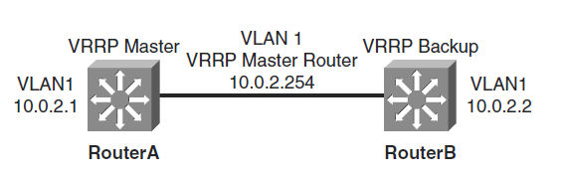
VRRP Configuration Example (1)
RouterA# configure terminal
Enter configuration commands, one per line. End with CNTL/Z.
RouterA(config)# interface vlan 1
RouterA(config-if)# ip address 10.0.2.1 255.255.255.0
RouterA(config-if)# vrrp 1 ip 10.0.2.254
RouterA(config-if)# vrrp 1 timers advertise msec 500
RouterA(config-if)# end
RouterB# configure terminal
Enter configuration commands, one per line. End with CNTL/Z.
RouterB(config)# interface vlan 1
RouterB(config-if)# ip address 10.0.2.2 255.255.255.0
RouterB(config-if)# vrrp 1 ip 10.0.2.254
RouterB(config-if)# vrrp 1 priority 90
RouterB(config-if)# vrrp 1 timers learn
RouterB(config-if)# end
Notes:
This example illustrates a user configuring and verifying VRRP on Router A and Router B for the scenario.

Slide 52
VRRP Configuration Example (2)
RouterA# show vrrp interface vlan 1
Vlan1 - Group 1
State is Master
Virtual IP address is 10.0.2.254
Virtual MAC address is 0000.5e00.0101
Advertisement interval is 0.500 sec
Preemption is enabled
min delay is 0.000 sec
Priority is 100
Master Router is 10.0.2.1 (local), priority is 100
Master Advertisement interval is 0.500 sec
Master Down interval is 2.109 sec
RouterB# show vrrp interface vlan 1
Vlan1 - Group 1
State is Backup
Virtual IP address is 10.0.2.254
Virtual MAC address is 0000.5e00.0101
Advertisement interval is 0.500 sec
Preemption is enabled
min delay is 0.000 sec
Priority is 90
Master Router is 10.0.2.1, priority is 100
Master Advertisement interval is 0.500 sec
Master Down interval is 2.109 sec (expires in 1.745 sec)
Notes:
This example illustrates a user configuring and verifying VRRP on Router A and Router B for the scenario.
A main difference between HSRP and VRRP is that in VRRP, the backup router does not send advertisements.
Therefore, as shown in the example, the VRRP master is not aware of the current backup router.

Slide 53
VRRP and Authentication
The VRRP standard that was defined in RFC 2338 used plain-text and MD5 authentication, which was later revoked in RFC 3678 in RFC 5798.
However, Cisco IOS devices still support authentication mechanisms which follow RFC 2338.
With Cisco IOS devices, the default of VRRP for authentication is plain text, MD5 can be configured by specifying a key string or, as with HSRP, referencing a keychain.
Example of configuring MD 5 authentication for VRRP on R1's Ethernet0/1 interface:
R1(config)# interface ethernet 0/1
R1(config–if)# vrrp 1 authentication md5 key-string MyVRRP
You would then configure the same on R2
R2(config)# interface ethernet 0/1
R2(config–if)# vrrp 1 authentication md5 key-string MyVRRP

Slide 54
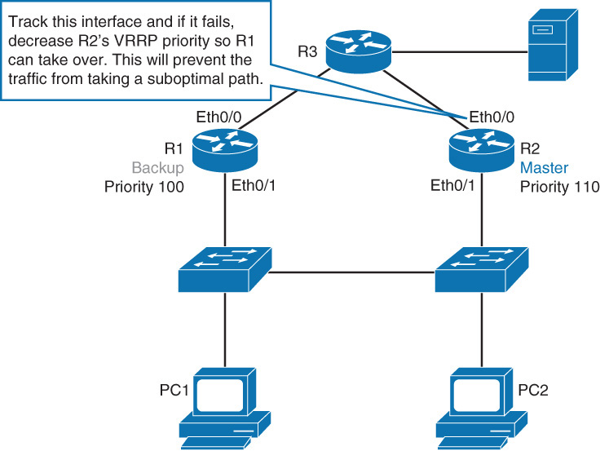
Tracking and VRRP
While VRRP does not have a native interface tracking mechanism, it does have the ability to track objects.
Examples of objects are can be tracked are the line protocol state of interface or the reachability of an IP route.
The following is an example of R2’s ethernet 0/0 line status tracked:
Create a tracked object:
R2(config)# track 1 interface ethernet 0/0
line-protocol
Configure VRRP to track the previously created object and
decrease VRRP priority by 20 should the link fail:
R2(config)# inteface ethernet 0/1
R2(config-if)# vrrp 1 track 1 decrement 20

Slide 55
Implementing VRRP on 3650 XE IOS
DLS2(config)# fhrp ver vrrp v3
DLS2(config)# interface Vlan10
DLS2(config-if)# ip address 172.16.10.1 255.255.255.0
DLS2(config-if)# vrrp 10 address-family ipv4
DLS2(config-if-vrrp)# address ip 172.16.10.5
DLS2(config-if-vrrp)# priority 150

Slide 56
Gateway Load Balancing Protocol (GLBP)
Notes:
Hosts and servers in a subnet need a gateway to reach devices that are not in the same subnet. Because gateways perform a key role in operations of all devices, their availability is paramount.
Providing redundant gateways is one solution but to ensure that they operate in a way that provides redundancy and load balancing, they need be configured for first hop redundancy protocol such as HSRP, VRRP, and GLBP.
This section covers the alternatives to gateway protocols and then explains each of the first hop redundancy protocols in detail.

Slide 57
Gateway Load Balancing Protocol (GLBP)
HSRP | GLBP
Cisco Proprietary, 1994 | Cisco Proprietary, 2005
16 groups max. | 1024 groups max.
1 active, 1 standby, several candidates. | 1 AVG, several AVF, AVG load balances traffic among AVF and AVGs
Virtual IP is different from Active and Standby real IP addresses. | Virtual IP is different from AVG and AVF real IP addresses
1 Virtual MAC address for each group | 1 Virtual MAC address per AVF/AVG in each group
Uses 224.0.0.2 for hello packets. | Uses 224.0.0.102 for hello packets.
Can track interfaces or objects. | Can track only objects.
Default timers: hello 3 s, holdtime 10 s | Default timers: hello 3 s, holdtime 10 s
Authentication supported | Authentication supported
Notes:
Although HSRP and VRRP provide gateway resiliency for the standby members of the redundancy group, the upstream bandwidth is not used while the device is in standby mode.
Only the active router for HSRP and VRRP groups forwards traffic for the virtual MAC.
Resources associated with the standby router are not fully utilized.
Some load balancing can be accomplished with these protocols through the creation of multiple groups and through the assignment of multiple default gateways, but this configuration creates an administrative burden.
GLBP is a Cisco-proprietary solution created to enable automatic selection and simultaneous use of multiple available gateways in addition to automatic failover between those gateways.
Multiple routers share the load of frames that, from a client perspective, are sent to a single default gateway address.
With GLBP, resources can be fully utilized without the administrative burden of configuring multiple groups and managing multiple default gateway configurations, as is required with HSRP and VRRP.
HSRP is typically used in Cisco networks as usually there are only two gateways for any subnet.
GLBP can be used if more than two gateways exist for subnets to load share across the gateways.

Slide 58
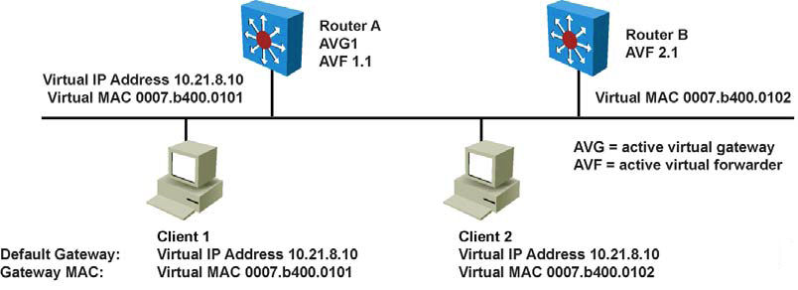
GLBP Functions (1)
GLBP active virtual gateway (AVG):Members of a GLBP group elect one gateway to be the AVG for that group. Other group members provide backup for the AVG if the AVG becomes unavailable. The AVG assigns a virtual MAC address to each member of the GLBP group.
GLBP active virtual forwarder (AVF): Each gateway assumes responsibility for forwarding packets that are sent to the virtual MAC address assigned to that gateway by the AVG. These gateways are known as AVFs for their virtual MAC address.
GLBP communication: GLBP members communicate between each other through hello messages sent every 3 seconds to the multicast address 224.0.0.102, User Datagram Protocol (UDP) port 3222.
Notes:
Router A is acting as the AVG. Router A has assigned virtual MAC 0007.b400.0101 to itself.
Router B is acting as AVF for the virtual MAC 0007.b400.0102 assigned to it by Router A.
Client 1 default gateway is Router A.
Client 2 default gateway is Router B based on the virtual MAC assignment.

Slide 59
GLBP Functions (2)
Router A is acting as the AVG. Router A has assigned virtual MAC 0007.b400.0101 to itself.
Router B is acting as AVF for the virtual MAC 0007.b400.0102 assigned to it by Router A.
Client 1 default gateway is Router A.
Client 2 default gateway is Router B based on the virtual MAC assignment.
Active Virtual Gateway (AVG) assigns each router in the group a unique virtual MAC address, following the format: 0007.B40x.xxyy (where xxx is the GLBP group number and yy indicates the active virtual forwarder (AVF) number, (01, 02…)
Notes:
GLBP active virtual gateway (AVG):Members of a GLBP group elect one gateway to be the AVG for that group.
Other group members provide backup for the AVG if the AVG becomes unavailable.
The AVG assigns a virtual MAC address to each member of the GLBP group.
GLBP active virtual forwarder (AVF): Each gateway assumes responsibility for forwarding packets that are sent to the virtual MAC address assigned to that gateway by the AVG.
These gateways are known as AVFs for their virtual MAC address.
GLBP communication: GLBP members communicate between each other through hello messages sent every 3 seconds to the multicast address 224.0.0.102, User Datagram Protocol (UDP) port 3222

Slide 60
GLBP Features
Load sharing: You can configure GLBP in such a way that multiple routers can share traffic from LAN clients, thereby sharing the traffic load more equitably among available routers.
Multiple virtual routers: GLBP supports up to 1024 virtual routers (GLBP groups) on each physical interface of a router and up to four virtual forwarders per group.
Preemption: The redundancy scheme of GLBP enables you to preempt an AVG with a higher priority backup virtual gateway that has become available. Forwarder preemption works in a similar way, except that forwarder preemption uses weighting instead of priority and is enabled by default.
Efficient resource utilization: GLBP makes it possible for any router in a group to serve as a backup, which eliminates the need for a dedicated backup router because all available routers can support network traffic.
Notes:
GLBP provides upstream load sharing by utilizing the redundant uplinks simultaneously.
It uses link capacity efficiently, thus providing peak-load traffic coverage.
By making use of multiple available paths upstream from the routers or Layer 3 switches running GLBP, output queues may also be reduced.
Only a single path is used with HSRP or VRRP, while others are idle, unless multiple groups and gateways are configured.
The single path may encounter higher output queue rates during peak times, which leads to lower performance from higher jitter rates.
The impact of jitter is lessened and overall performance is increased because more upstream bandwidth is available, and additional upstream paths are used.

Slide 61
GLBP Operations (1)
Operational modes for load balancing:
Weighted load-balancing algorithm: The amount of load directed to a router is dependent upon the weighting value advertised by that router.
Host-dependent load-balancing algorithm: A host is guaranteed use of the same virtual MAC address as long as that virtual MAC address is participating in the GLBP group.
Round-robin load-balancing algorithm: As clients send ARP requests to resolve the MAC address of the default gateway, the reply to each client contains the MAC address of the next possible router in round-robin fashion. All routers’ MAC addresses take turns being included in address resolution replies for the default gateway IP address.
Notes:
GLBP allows automatic selection and simultaneous use of all available gateways in the group.
The members of a GLBP group elect one gateway to be the AVG for that group.
Other members of the group provide backup for the AVG if it becomes unavailable.
The AVG assigns a virtual MAC address to each member of the GLBP group.
All routers become AVFs for frames addressed to that virtual MAC address.
As clients send Address Resolution Protocol (ARP) requests for the address of the default gateway, the AVG sends these virtual MAC addresses in the ARP replies.
A GLBP group can have up to four group members.
GLBP automatically manages the virtual MAC address assignment, determines who handles the forwarding, and ensures that each station has a forwarding path if failures to gateways or tracked interfaces occur.
If failures occur, the load-balancing ratio is adjusted among the remaining AVFs so that resources are used in the most efficient way.

Slide 62
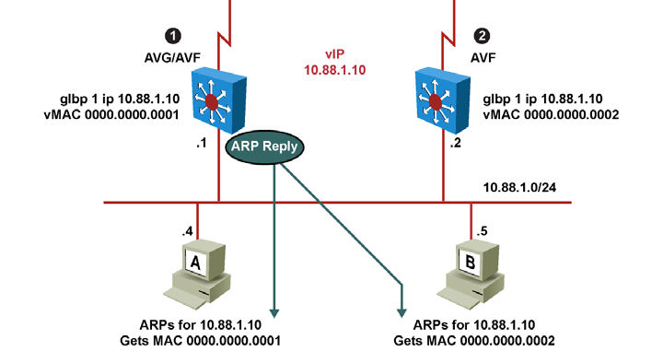
GLBP Operations (2)
By default, GLBP attempts to balance traffic on a per-host basis using the round-robin algorithm.
When a client sends an ARP message for the gateway IP address, the AVG returns the virtual MAC address of one of the AVFs.
When a second client sends an ARP message, the AVG returns the next virtual MAC address from the list.

Slide 63
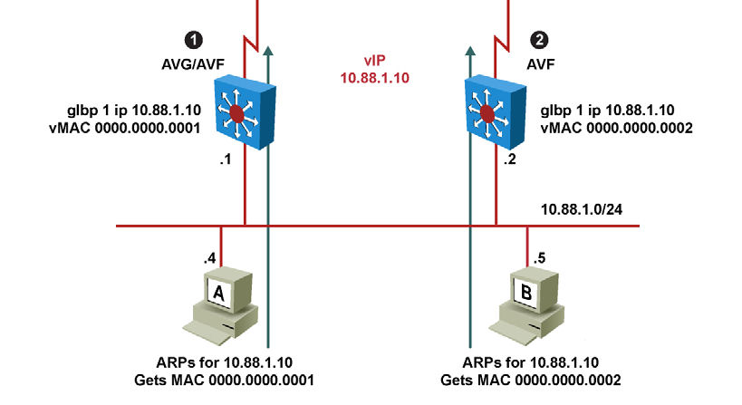
GLBP Operations (3)
Having each resolved a different MAC address for the default gateway, Clients A and B send their routed traffic to separate routers, although they both have the same default gateway address configured.
Each GLBP router is an AVF for the virtual MAC address to which it has been assigned.

Slide 64
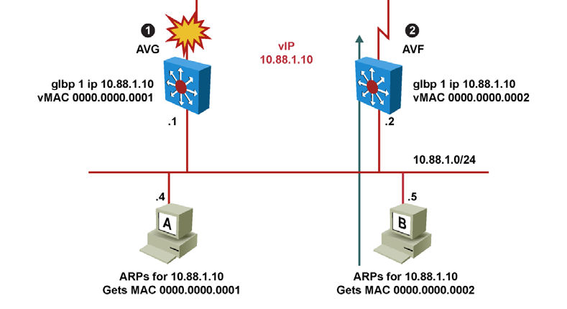
GLBP Interface Tracking (1)
Like HSRP, GLBP can be configured to track interfaces via objects
The WAN link from Router R1 is lost. GLBP detects the failure. Just like HSRP, GLBP decrements the gateway priority when a tracked interface fails. The second gateway then becomes primary. This transition is transparent for the LAN client.

Slide 65
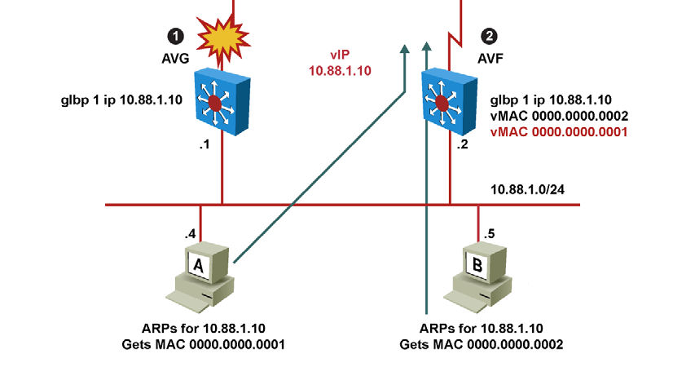
GLBP Interface Tracking (2)
Because interface tracking was configured on R1, the job of forwarding packets for virtual MAC address 0000.0000.0001 will be taken over by the secondary virtual forwarder for the MAC, Router R2. Therefore, the client sees no disruption of service nor does the client need to resolve a new MAC address for the default gateway.
Notes:
GLBP weighting determines whether a router can act as a virtual forwarder.
Initial weighting values can be set and optional thresholds specified.
Interface states can be tracked and a decrement value set to reduce the weighting value if the interface goes down.
When the GLBP router weighting drops below a specified value, the router will no longer be an active virtual forwarder.
When the weighting rises above a specified value, the router can resume its role as an active virtual forwarder.
The GLBP weighting mechanism is different from HSRP or VRRP. With HSRP and VRRP, one single threshold is defined.
If the router priority (or weight) falls below the threshold,the router loses its active state. As soon as the router weight (or priority) exceeds the threshold, the router regains its active state.
With GLBP, two thresholds are defined: one lower threshold that applies when the router loses weight, and one upper threshold that applies when the router regains weight.
This double threshold mechanism enables more flexibility than the single threshold system.

Slide 66
GLBP Weight
GLBP uses a weighting scheme to determine the forwarding capacity of each router in the GLBP group.
The weighting that is assigned to a router in the GLBP group can be used to determine whether it will forward packets and, if so, the proportion of hosts in the LAN for which it will forward packets.
Thresholds can be set to disable forwarding when the weighting for a GLBP group falls below a certain value, and when it rises above another threshold, forwarding is automatically reenabled.
By default, the GLBP virtual forwarder preemptive scheme is enabled with a delay of 30 seconds.
A backup virtual forwarder can become the AVF if the current AVF weighting falls below the low weighting threshold for 30 seconds.
To disable the GLBP forwarder preemptive scheme, use the no glbp forwarder preempt command or change the delay by using the glbp forwarder preempt delay minimum command.

Slide 67
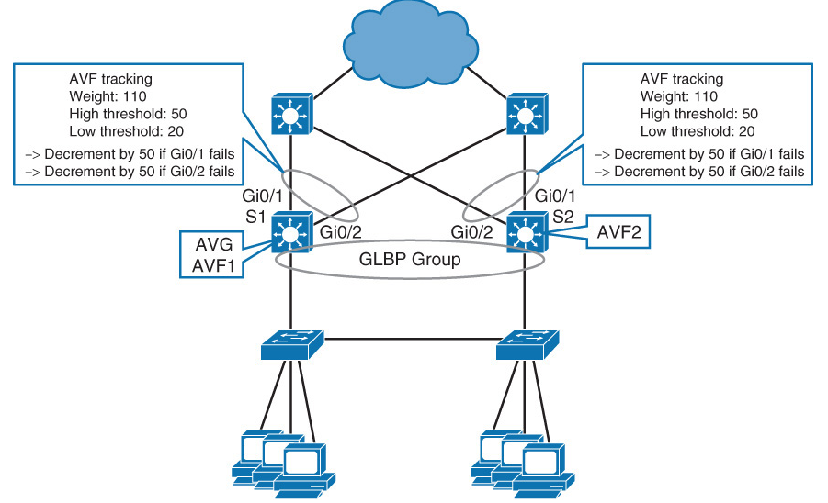
Tracking and GLBP
Changing weight affects the AVF election and the load-balancing algorithm.
Both values can be manipulated with object tracking.

Slide 68
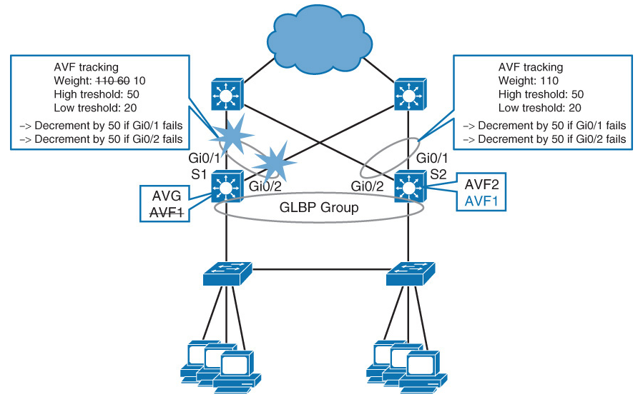
GLBP Tracking Detects Interface Failure

Slide 69
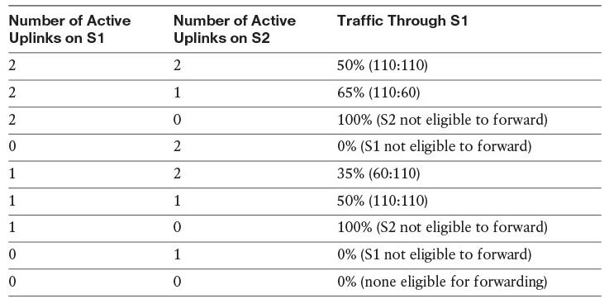
GLBP Weighing Option Under Failures
If load balancing is configured as round-robin, then, as long as both S1 and S2 are eligible to forward, traffic will be about 50:50 between both first hops.
Notes:
If load balancing is configured as round-robin, then, as long as both S1 and S2 are eligible to forward, traffic will be about 50:50 between both first hops.

Slide 70
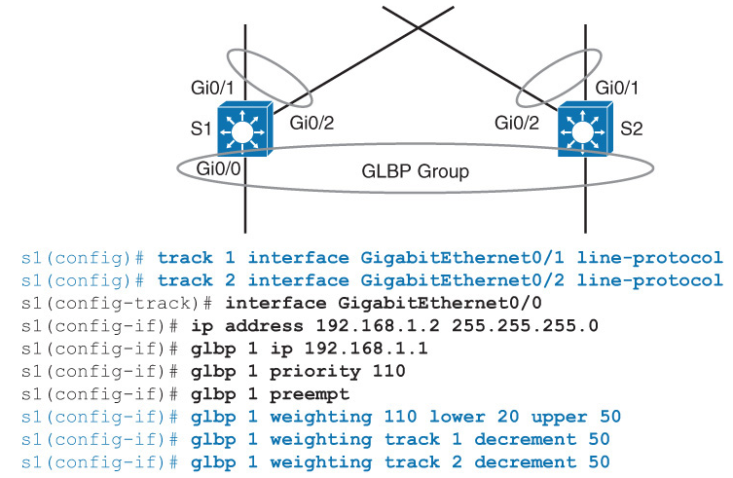
GLBP Object Tracking Sample Configuration

Slide 71
Configuring GLBP
Step | Description
1. | Enable GLBP on an interface. This command makes the interface a member of the virtual group identified with the IP virtual address: Switch(config-if)#glbp group-number ip virtual-gateway-address
2. | Set a GLBP priority for this router for this GLBP group. The highest value wins election as active router. The default is 100. If routers have the same GLBP priority, the gateway with the highest real IP address becomes the AVG: Switch(config-if)#glbp group-number priority priority-value
3. | Change timer values for hello interval and holdtime. Place the argument msec before the values to enter subsecond values: Switch(config-if)#glbp group-number timers hello holdtime
Notes:
Steps needed to configure GLBP.

Slide 72
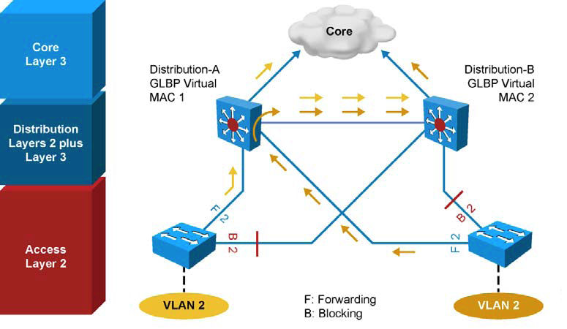
GLBP with VLAN Spanning Access Switches
Although invisible and transparent to VLAN 2 clients, the STP blocking state on the access uplink results in the frames coming from VLAN 2 transiting through Distribution A and then through Distribution B before being sent to the core.
In environments in which VLANs span across access switches, HSRP is the recommended first hop redundancy protocol implementation. In all cases, the active gateway should be configured to also be the root bridge for the VLAN in which first hop redundancy is configured.
Notes:
The figure depicts a topology in which STP has blocked one of the access uplinks, and this might result in a two-hop path at Layer 2 for upstream traffic when GLBP is configured at the distribution layer.
In the example, Distribution A switch has a direct connection to the core and a redundant link to Distribution B.
Because of spanning-tree operations, the interface directly linking to the core is in blocking state.

Slide 73
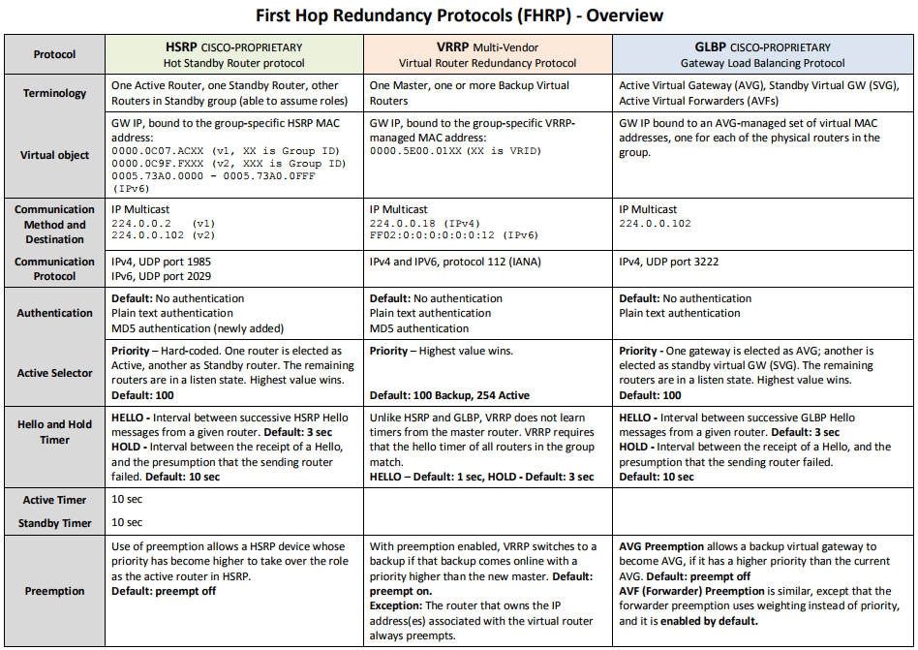
FRP Summary

Slide 74
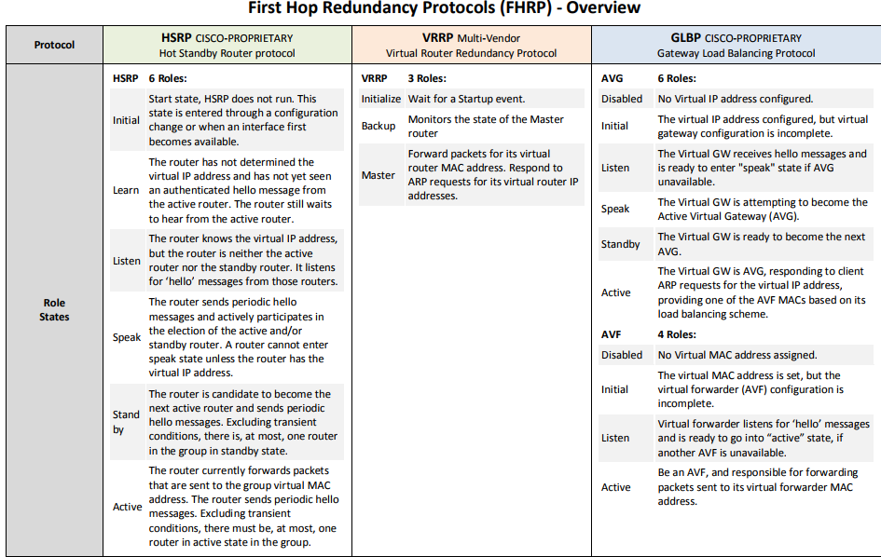
FRP Summary

Slide 75
Resources
Catalyst 3560 Command Reference
www.cisco.com/en/US/partner/docs/switches/lan/catalyst3560/software/release/12.2_55_se/command/reference/3560_cr.html
Configuring HSRP:
www.cisco.com/en/US/partner/docs/switches/lan/catalyst3560/software/release/12.2_55_se/configuration/guide/swhsrp.html
Configuring VRRP:
www.cisco.com/en/US/partner/docs/ios/ipapp/configuration/guide/ipapp_vrrp.html
Configuring GLBP:
www.cisco.com/en/US/partner/docs/ios/ipapp/configuration/guide/ipapp_glbp.htm
Configuring Enhanced Object Tracking:
www.cisco.com/en/US/partner/docs/switches/lan/catalyst3560/software/release/12.2_55_se/configuration/guide/sweot.html

Slide 76


